Slide 1
HIV Recency Testing Preliminary experiences from Vietnam
Dr. Nguyen Hoang Long Director General, Vietnam Authority of HIV/AIDS Control (VAAC)

Slide 2
Contents
Implementation timeline
Some initial findings
Conclusions

Slide 3
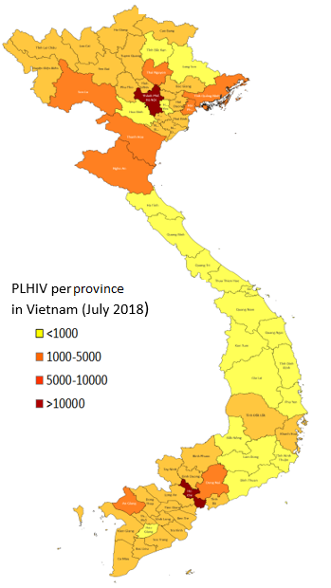
HIV/AIDS Epidemic in Vietnam: Key Facts
96 millions pop
250.000 PLWH
Concentrated epidemic: PWID (14%), MSM (12%), FSWs (3,6%)
Reduce 2/3 during last 10 years.
90-90-90 Targets:
80-70-95

Slide 4
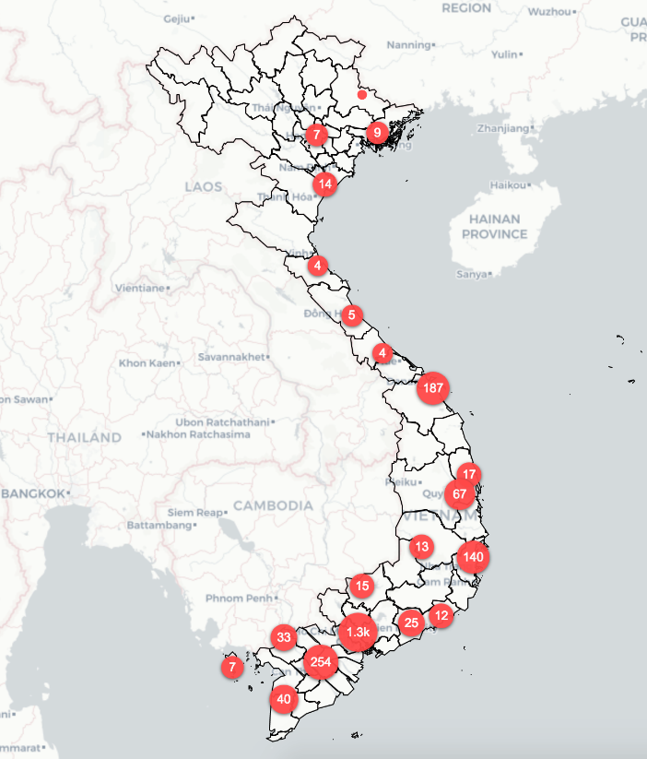
Recency Testing Implementation timeline
Jun 2018
Recency testing with 804 stored samples from 3 provinces
Jul 2019
Feb 2019
Dec 2017
In-country lab validation
Routine recency testing in 10 PEPFAR supported provinces
Integrate in the HIV surveillance system (HSS+) in 20 provinces
2020+
Intergrate in the National HIV testing algorithm (?)
Nationwide implementation (?)

Slide 5
Recency Testing on 804 Stored Samples to Better Understand the HIV epidemic, May 2018
Highland/Mountainous
Midland
Urban/City

Slide 6
Recent Testing in 86 stored-samples, MSM cohort, Hanoi 2017
HIGH + YOUNG!
Recent Infections: 34.9%
Average age: 23 yrs
86 stored-samples
Recency test and HIV VL
39 tested
Recent
45 tested
Long-term
2 tested
negative
30 confirmed recent (34.9%)
(Tested recent + VL≥1,000 copies/mL)

Slide 7
Routine recency testing in 10 PEPFAR supported provinces, Feb – May 2019
Province | Number tested on RTRI | Number tested RTRI-recent | Number RTRI – recent tested HIV VL | Number confirm – recent (VL>1000 cp/ml)
Long An | 34 | 12 | 9 | 7
Đồng Nai | 115 | 37 | 37 | 27
Binh Duong | 100 | 22 | 22 | 17
Tây Ninh | 47 | 19 | 10 | 10
Tiền Giang | 55 | 8 | 2 | 1
BR-Vũng Tàu | 114 | 11 | 9 | 5
HCMC | 243 | 33 | 31 | 30
Hải Phòng | 51 | 6 | 6 | 4
Hà Nội | 425 | 42 | 19 | 8
Thái Nguyên | 36 | 3 | 3 | 1
Total | 1,220 | 184 | 148 | 110
Start: Feb 2019
So far, 1,220 tests conducted/5 mths
Confirmed with VL: 110 (9.0%) (some provinces did not carry out VL for all samples)

Slide 8
Recent Infection Among Target Group, Feb–May 2019

Slide 9
Integrated Recency Test in National HSS+ in 20 Provinces, 2018
To estimate proportion of recent infection among HIV positives and HIV incidence rate among KPs.
Results:
Highest recent infection: MSM 6.34%.
Incidence rate among MSM: 1.7% (per 100-person years)

Slide 10
Recency Testing and Index-partner Testing: An Example from Binh Chanh District, Ho Chi Minh City
INDEX Recent HIV+ Case (MSM, 22 Age)
Part 1: HCMC – 155, MSM, Neg
Part 2: HCMC – 156, MSM, Neg
Part 3: HCMC – 157, MSM, Neg
Part 4: HCMC – 158, POS, LT; 30 yrs
Counselling
PrEP
PrEP
PrEP
ART

Slide 11
Integrate Recency Testing into National HIV Testing Algorithm?
[1] To be approved by MOH as diagnostic test
Meet national requirements for licensing and importing to Vietnam.
[2] To be included in the MOH’s HIV testing guideline
Meet national requirements on Sen (>99.5%) & Spec (> 98%)
[3] To be used nationwide at the sites
Recommended by WHO
Available in the markets
Reasonable price

Slide 12
Conclusions
Recency testing is useful to better understand the HIV/AIDS epidemics, especially estimate the new infection/incidence in different KPs, geographical areas for proper interventions.
Recency testing, combined with index-testing, helps to find partners for proper prevention (e.g., PrEP) and ARV treatment timely.
Further steps need to be done to include Recency testing in Vietnam’s national HIV testing algorithm as a HIV diagnostic test.

Slide 13
Ha Long Bay, Vietnam

